Slide 1
Restaurant Ordering System
A simple solution to common problems
Presented by Calder, Xenon, Nguyen, Shawn
Notes:
Hello everyone, we are group 4, and Our project idea is to make a back-end for a restaurant ordering system. Now, a back-end ordering system is the process of the restaurant making an order to a supplier, who then delivers the order to the restaurant after some amount of time. The exacts of this operation can vary, but generally it follows that rule. So we have decided to make a system to assist and streamline this procedure.

Slide 2
What is the system, and how does it do it?
What is the objective of the system?
How does the system allow you to complete the objective?
To let people order inventory items through the use of a computer with an online connection
Through a website that is connected to the supplier, the user can use various forms to add and remove items in an order and have that order be automatically sent to the supplier

Slide 3
Title and Content Layout with Chart

Slide 4
Problem: Making a restaurant backend ordering system
Restaurant Backend Ordering:
Regular and Special Supplies
Current order
History
Options (Order Settings)
Login page (registered customer)
5 Primary Tasks
Notes:
Nguyen
Note: Introduce the major problem and identify the primary tasks for this problem.
Primary Tasks include regular, special supplies, current order, history, options and login page

Slide 5
Issues & Solutions
Issues | Solutions
Big image in the login page | Removed
No pricing information | Added
The box holding items is small | Fixed
Unhide password | Fixed
Functions working incorrectly | Fixed
Notes:
Nguyen
Note: Expressing the issues that group had during the prototype. Giving solutions after developing the prototype

Slide 6
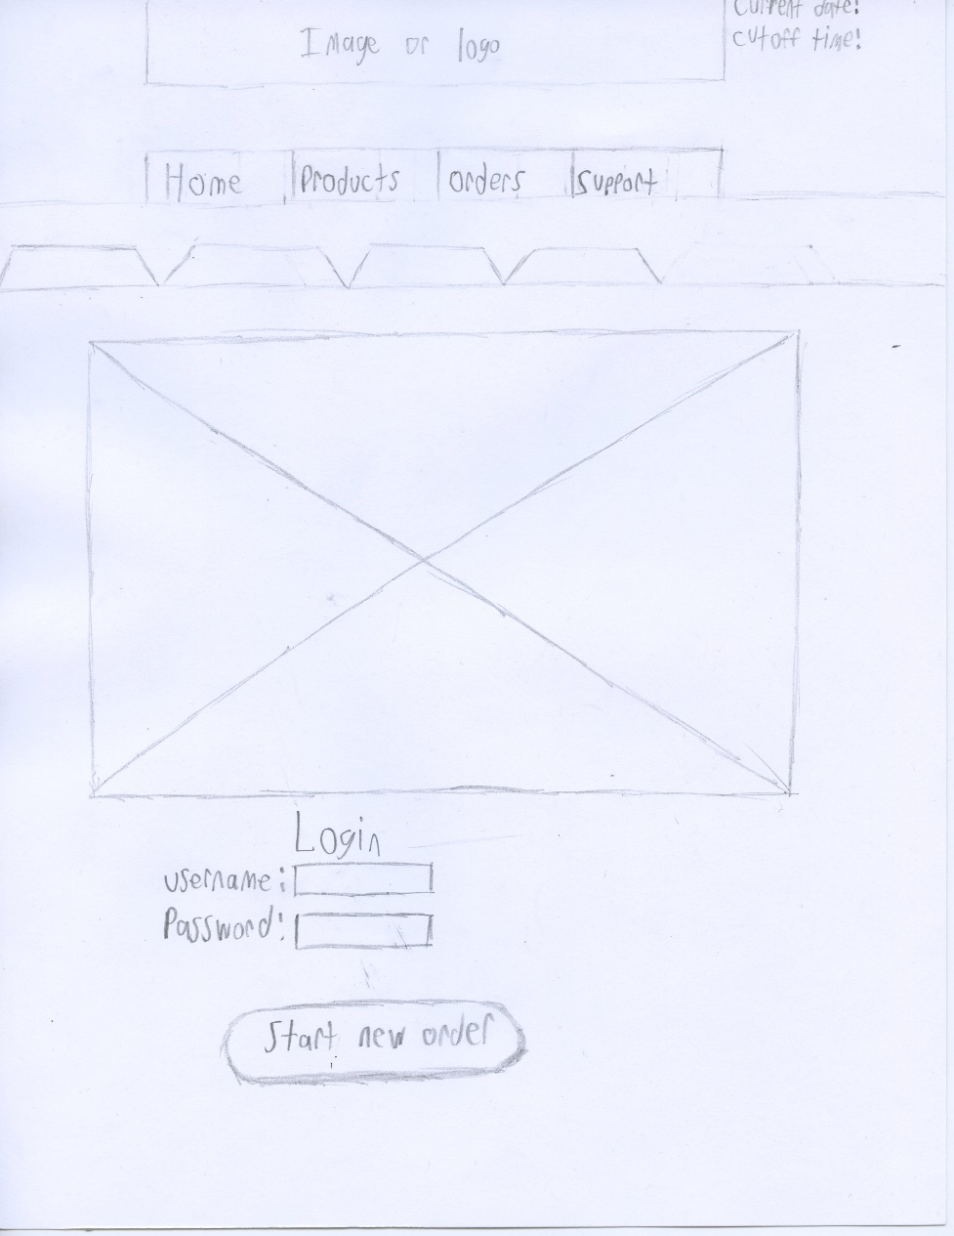
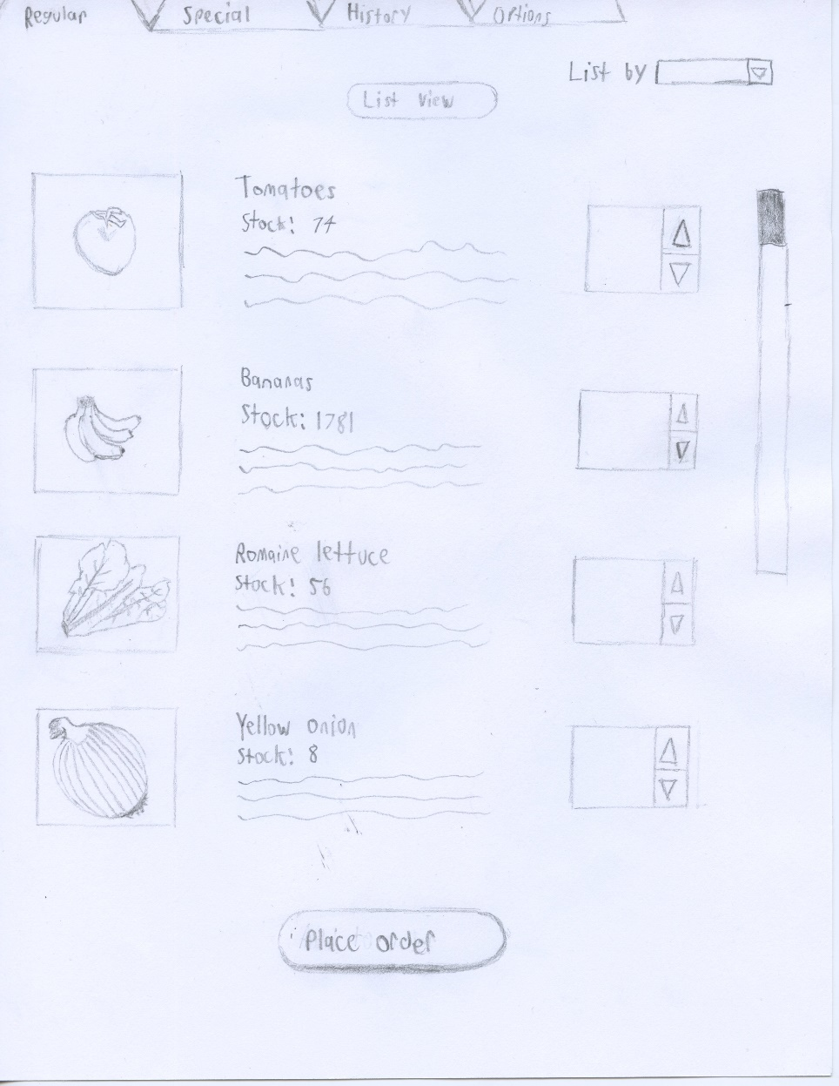
Notes:
Nguyen
Note:
Prototype pictures/sketches to show the issue

Slide 7
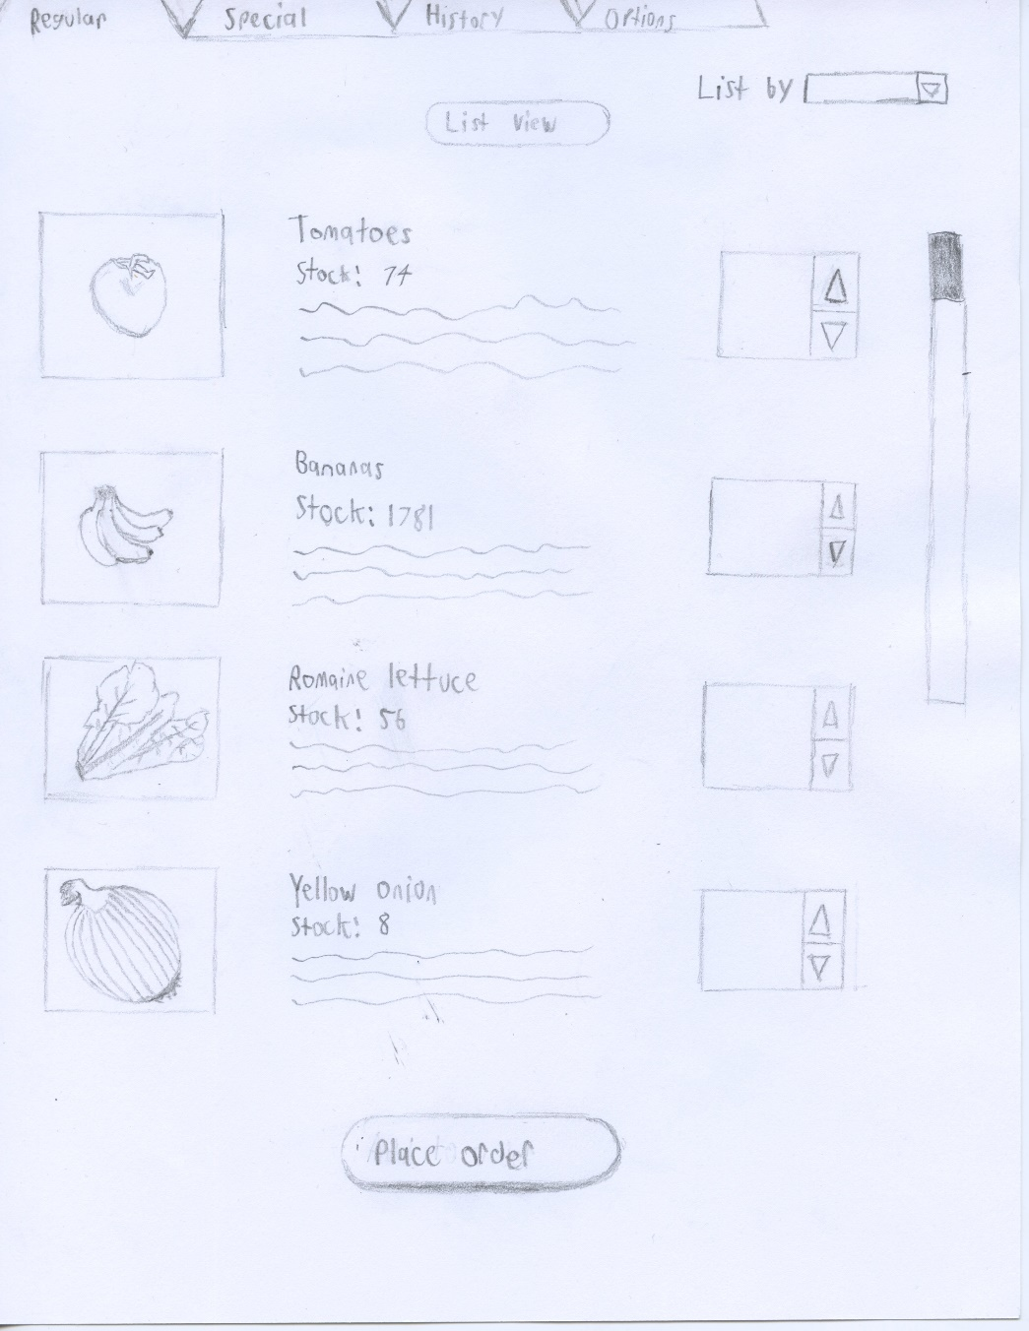
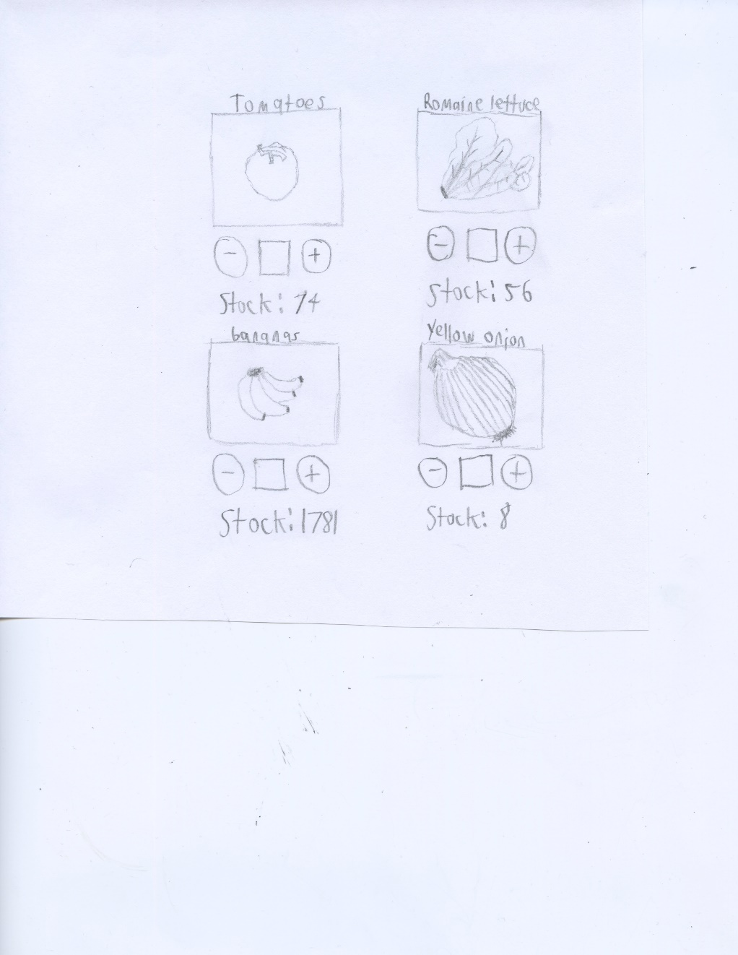
Notes:
Nguyen
Note:
Prototype pictures/sketches to show the issue

Slide 8
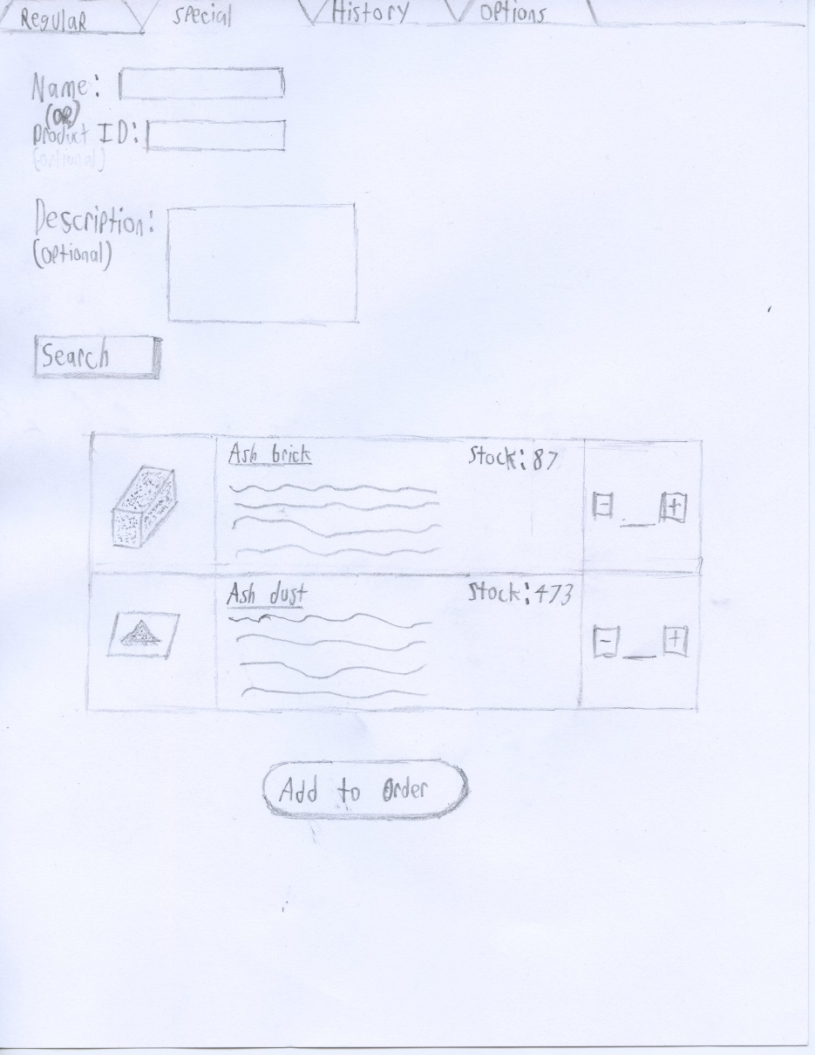
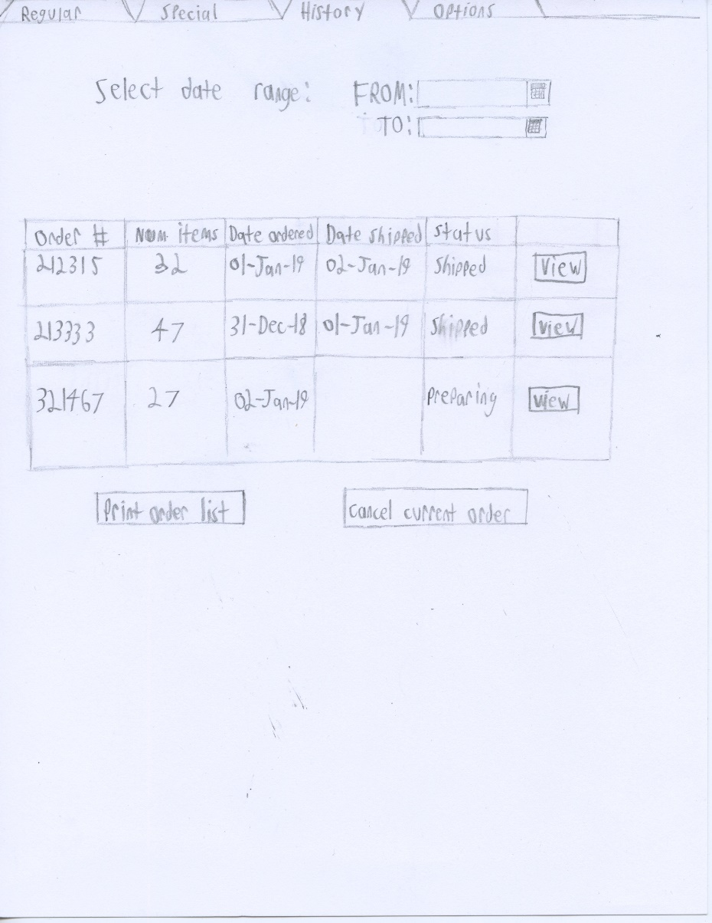
Notes:
Nguyen
Note:
Prototype pictures/sketches to show the issue

Slide 9
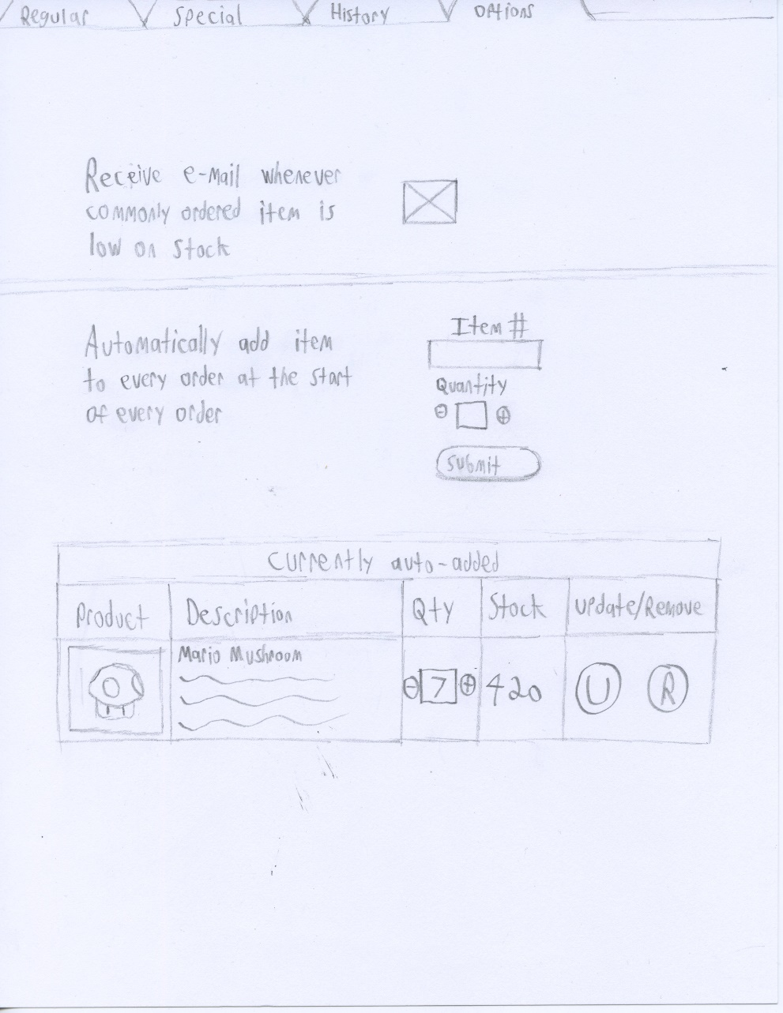
Notes:
Nguyen
Note:
Prototype pictures/sketches to show the issue

Slide 10
Key Interview Points
“…I wish some things were automatic. The computer system is super old and annoying to work with.”
“…the interface is my most concern. Interface must be simple and easy for user to use. “
“Online and connectivity issues arise, no email confirmation …”

Slide 11
Design Choices
Images for items
Color Scheme
How to Search

Slide 12
Add a Slide Title - 2

Slide 13
Two Content Layout with Table
First bullet point here
Second bullet point here
Third bullet point here
Class | Group A | Group B
Class 1 | 82 | 95
Class 2 | 76 | 88
Class 3 | 84 | 90

Slide 14
Two Content Layout with SmartArt
First bullet point here
Second bullet point here
Third bullet point here
Group A
Task 1
Task 2
Task 3

Slide 15
Add a Slide Title - 1

Slide 16
Add a Slide Title - 2

Slide 17
Add a Slide Title - 3

